Slide 1

STORE SALES PREDICTION
PREDICTING STORE SALES FOR VARIOUS ITEMS
vincebarokie

Slide 2
REPORT CONTENTS
Project Description
Dataset Preparation
Exploratory Analysis
Machine Learning Model
Recommendations

Slide 3
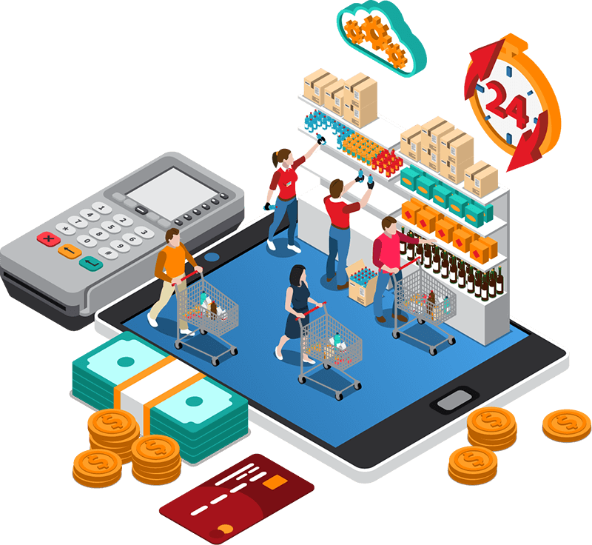
Project Description
This project is about sales prediction for food items sold at various stores.
The goal of this project is to help retailers understand the properties of products and outlets that play crucial roles in increasing their sales.
We will perform some data processing, exploratory analysis and fit our data to a machine learning model to achieve our goals.

Slide 4
Dataset Preparation
Machine Learning
We will fit our processed data to two(2) machine learning model and we will recommend which model we will use to predict the sales.
03
Data Preparation
Data is collected from various store outlets and loaded into one table for analysis.Our data will then be processed, cleaned and prepped for exploration and fitted to our machine learning model.
01
02
Exploratory Visualization
We will visualize our data to see how are data variables relating each other.

Slide 5
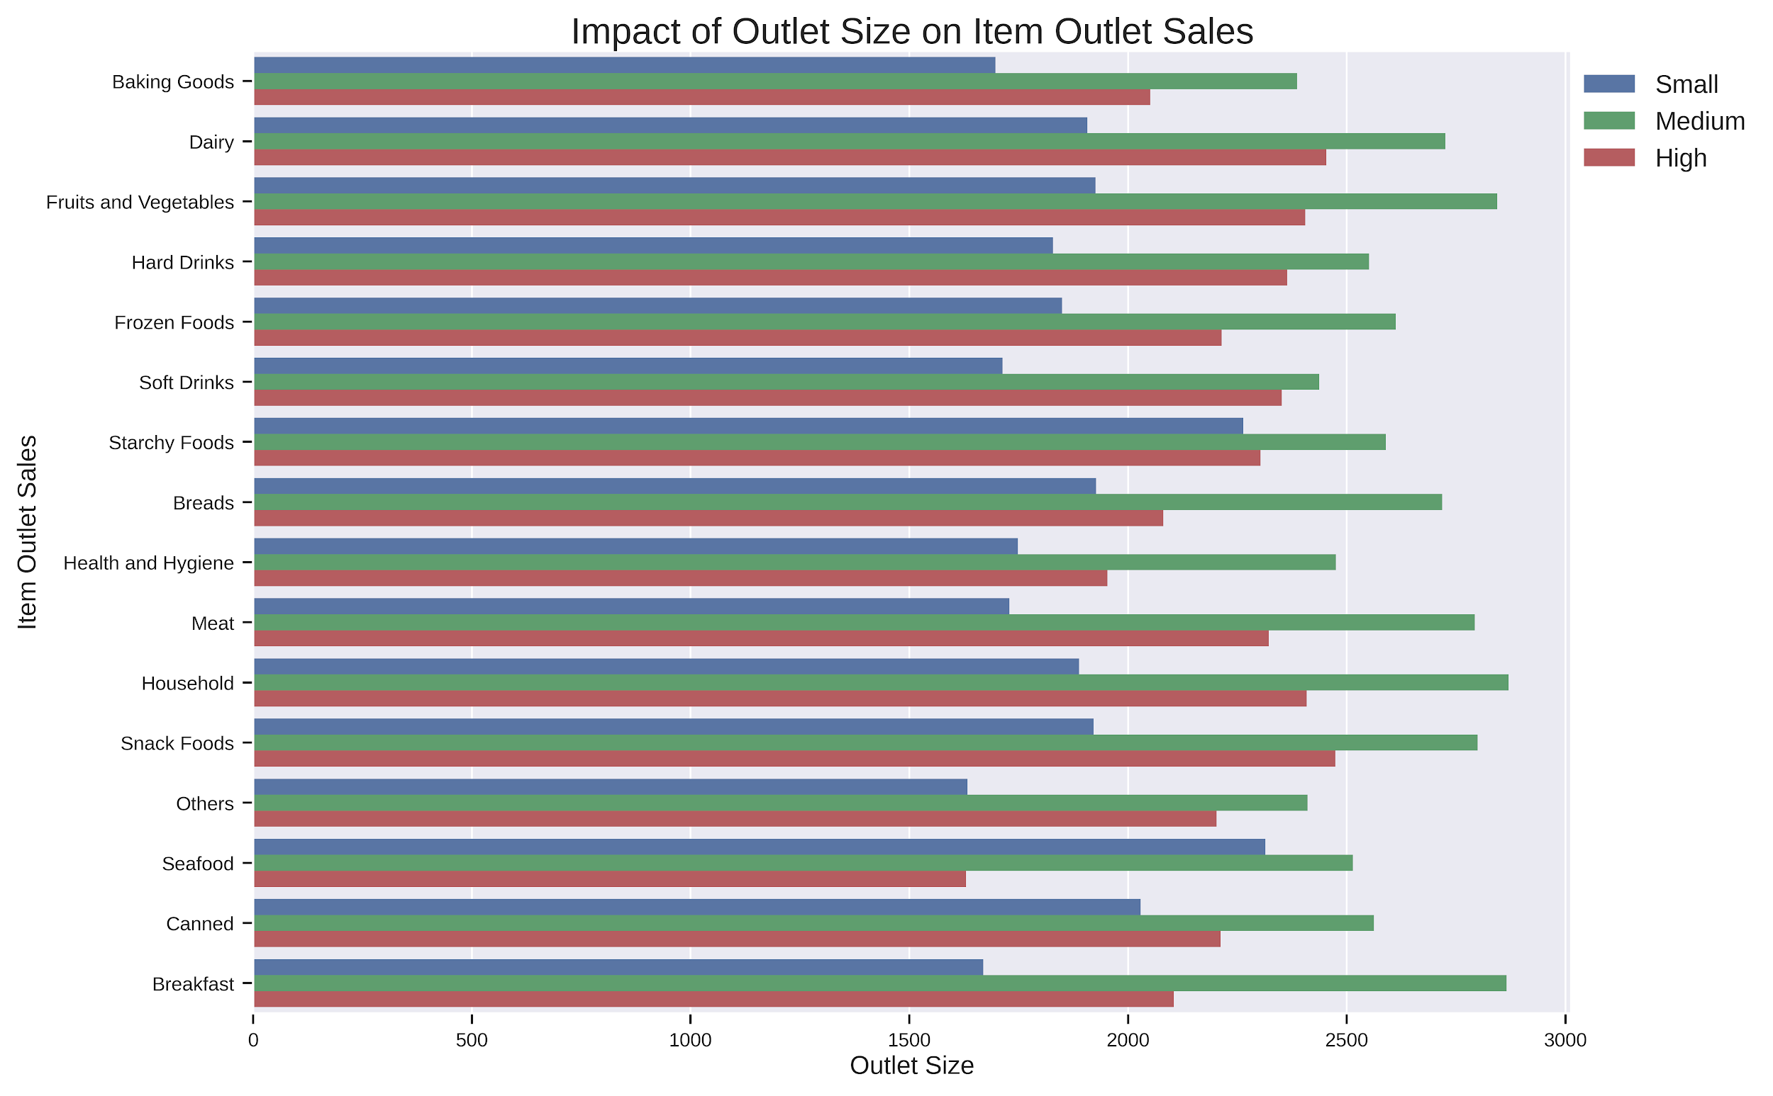
Exploratory Analysis
This tells us that all food item sales comes mostly from the “medium sized” store outlet, the “high” outlets comes in second.

Slide 6
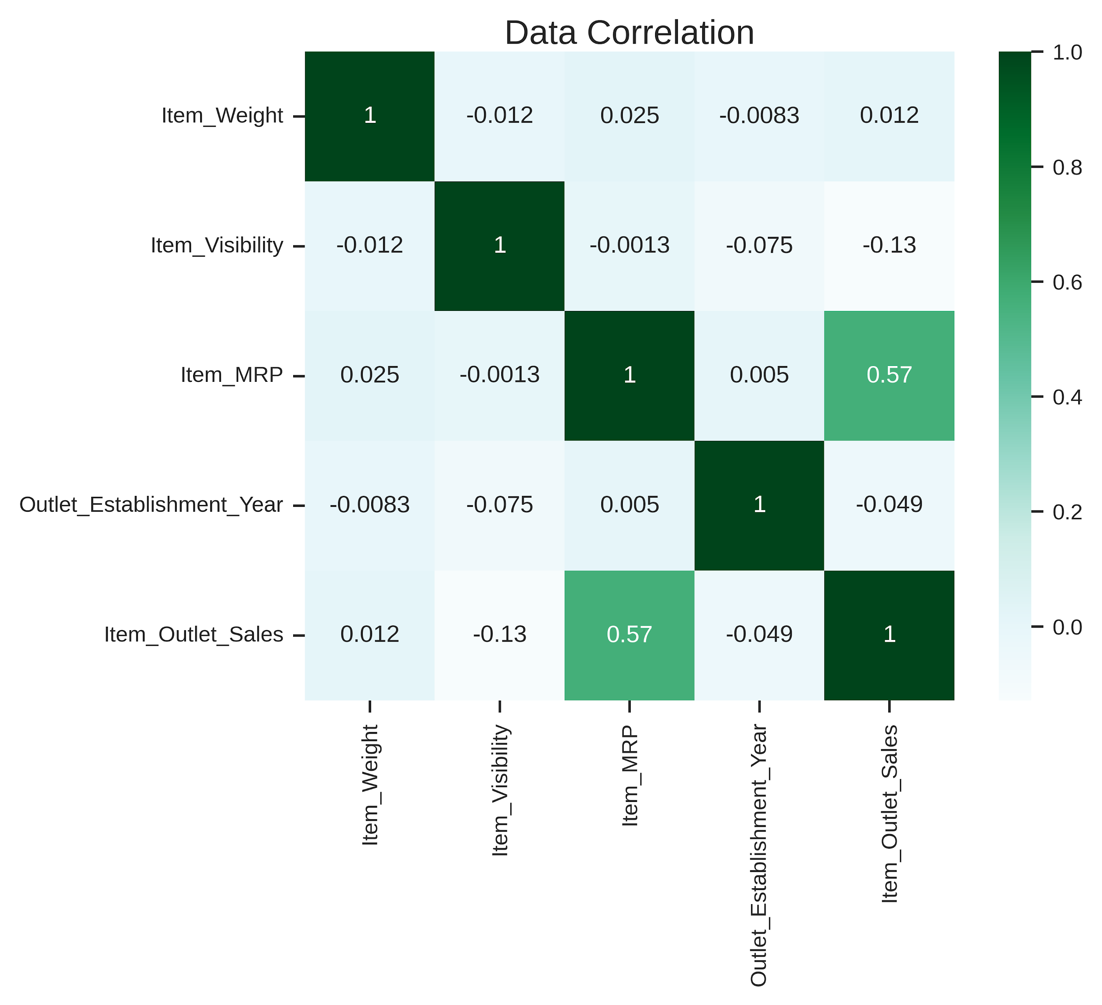
Exploratory Analysis
Item_MRP and Item Outlet Sales are positively correlated in our dataset and our machine learning model will be able to use this correlation to predict sales for various items.

Slide 7
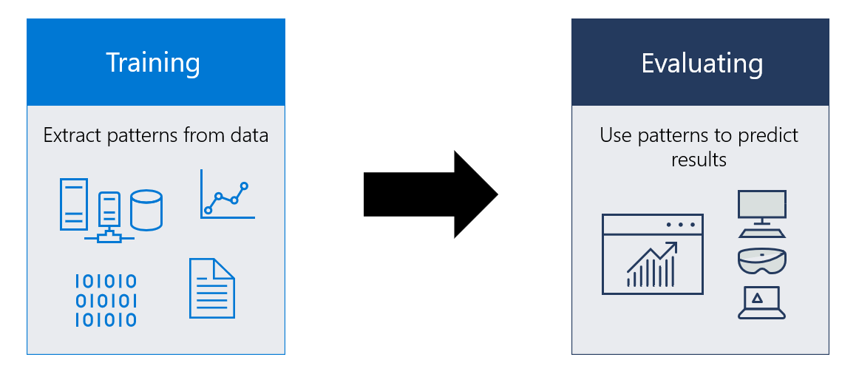
Machine Learning Model
After all the preprocessing and visual exploration, we now fit our data to our Machine Learning Model.
We are testing two models to get the best outcome and recommend which model we will be using moving forward.

Slide 8
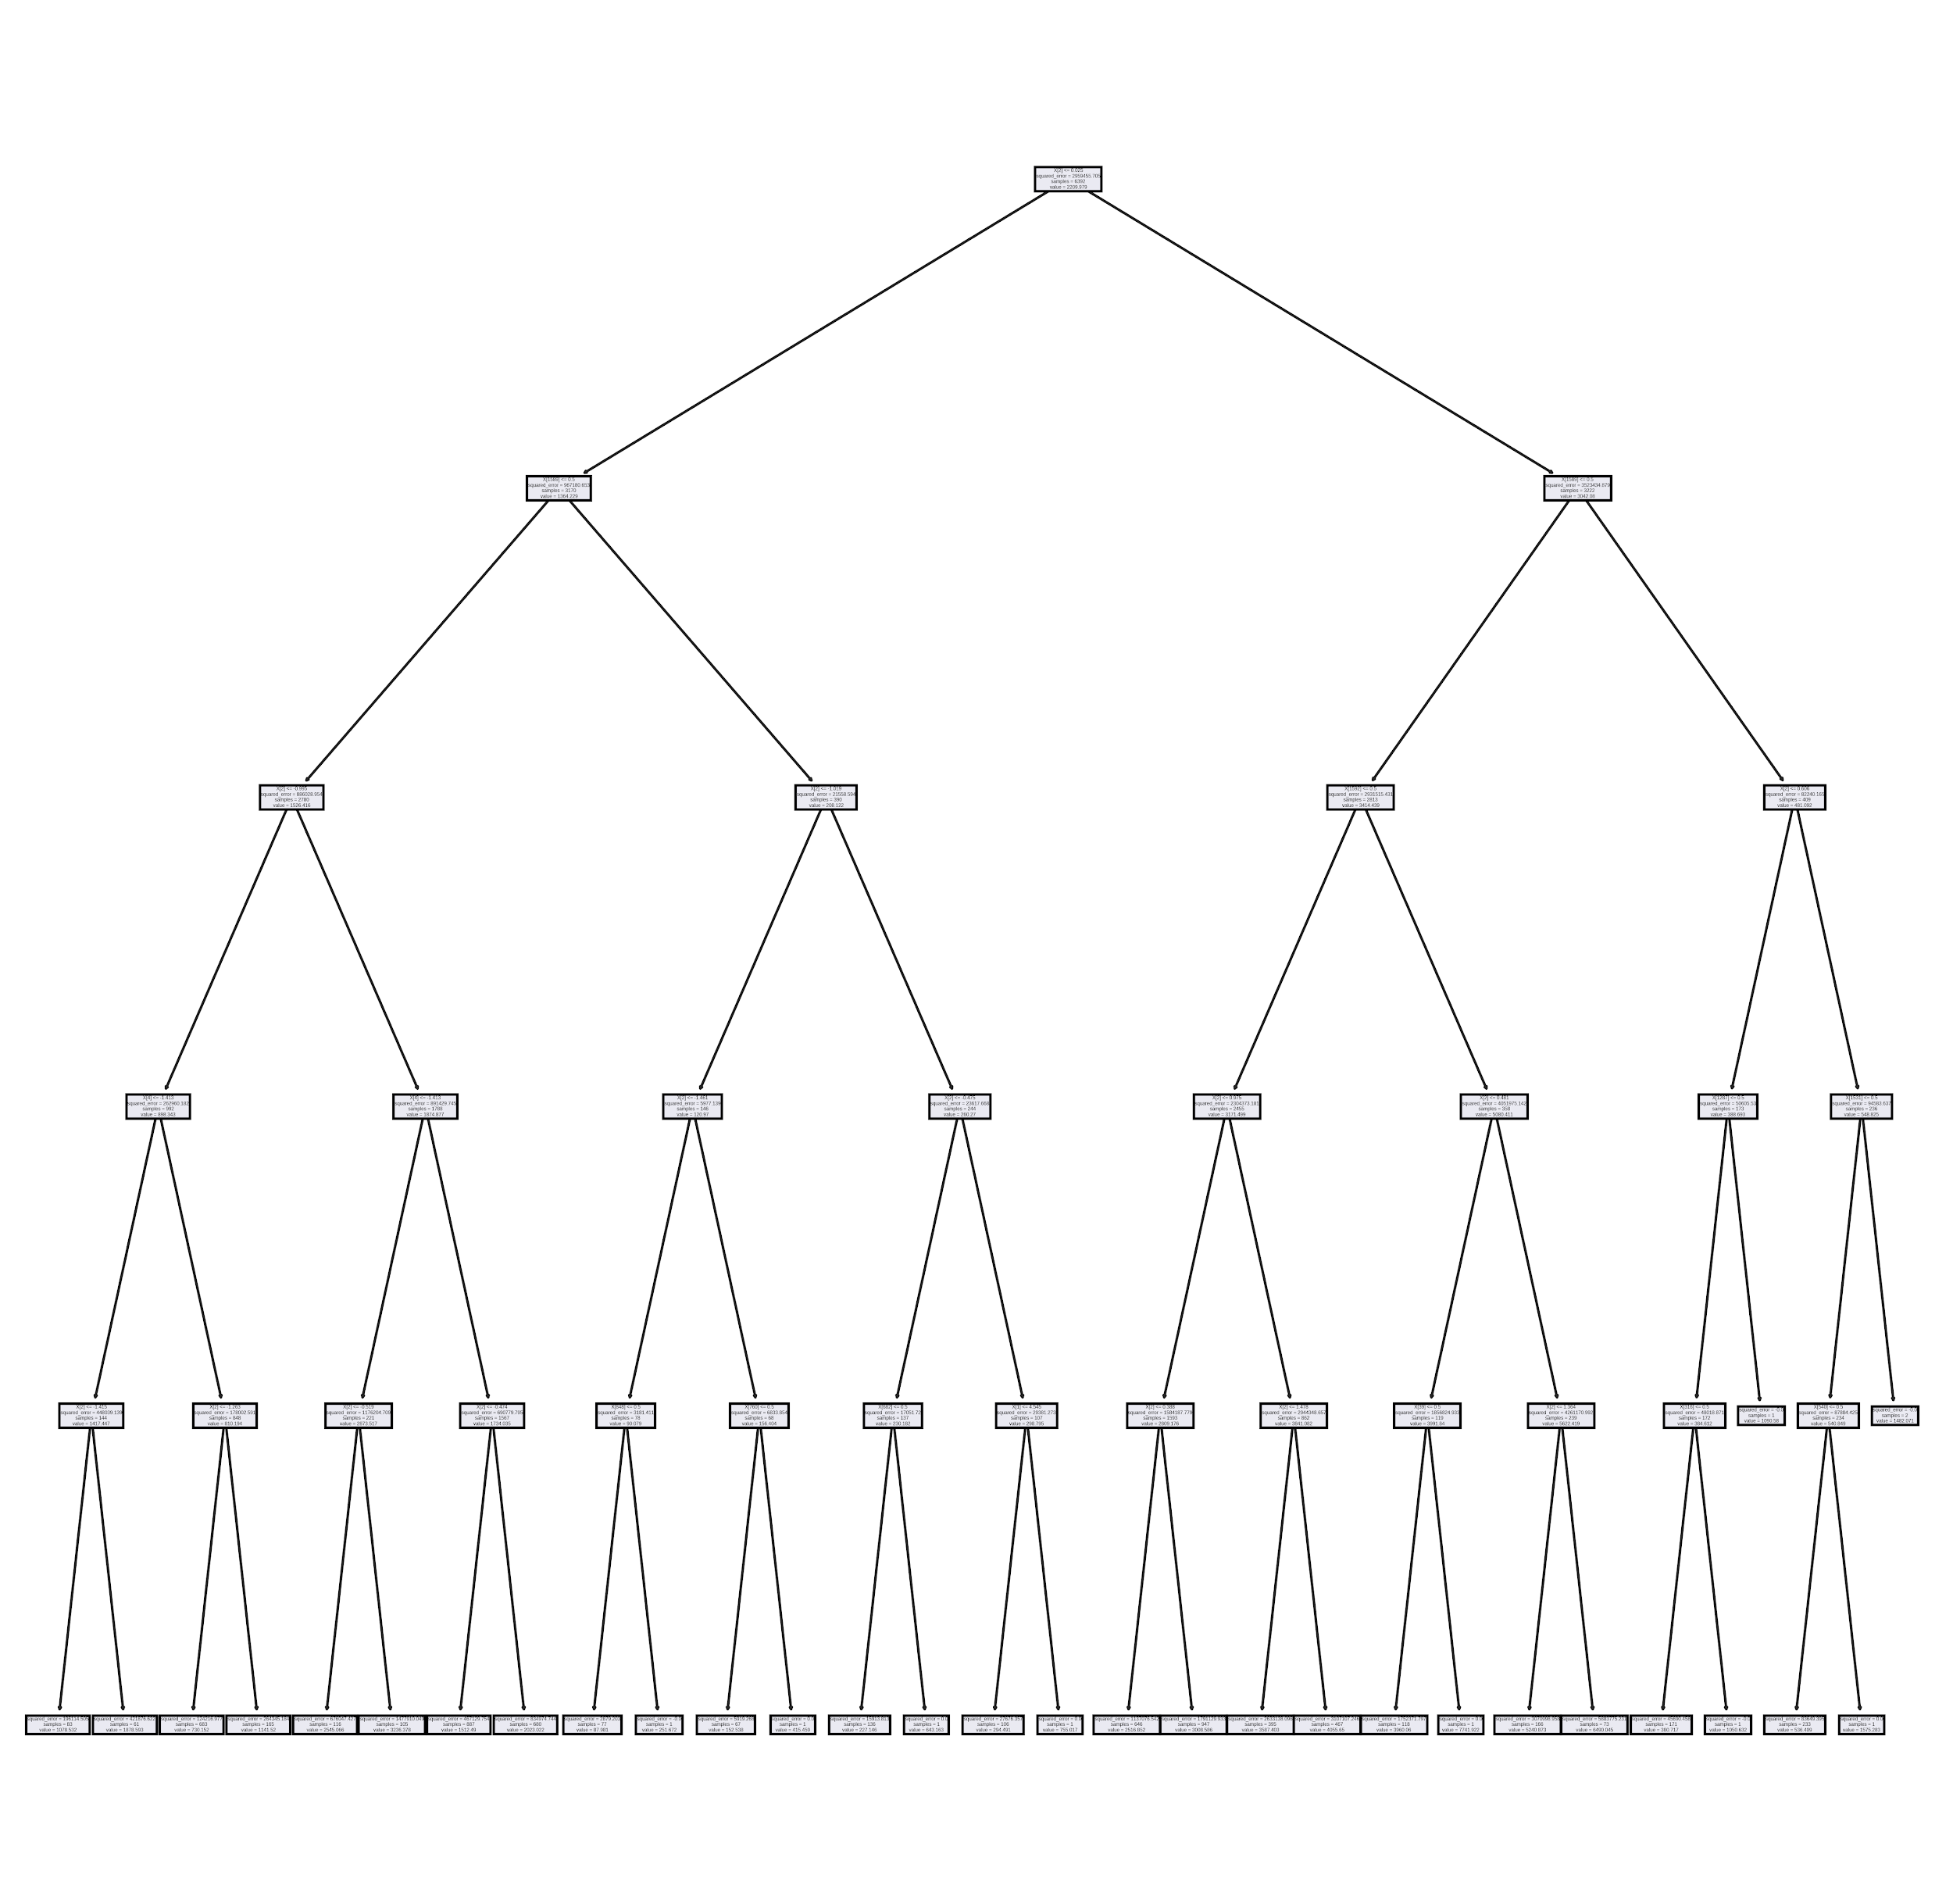
Recommendations
After testing both models, we are recommending to use Decision Tree Machine Learning model to properly predict the sales of various food items.
With this model, we were able to get the best results and this model can surely impact the sales of our retailers by selecting the best items for each outlets.

Slide 9
Thank you!

